Slide 1

Predicting Changes in Global Alliances
Heron Ziegel

Slide 2

OBJECTIVES & SIGNIFICANCE
Balance military alliance network
Create an algorithm that predicts what a network of military alliances looks like when moving toward balance
Predict and visualize future changes in alliances between nations
FIND trend toward balance
Discover trends in balance over time
Determine whether the above algorithm is useful for a given network based on past data

Slide 3
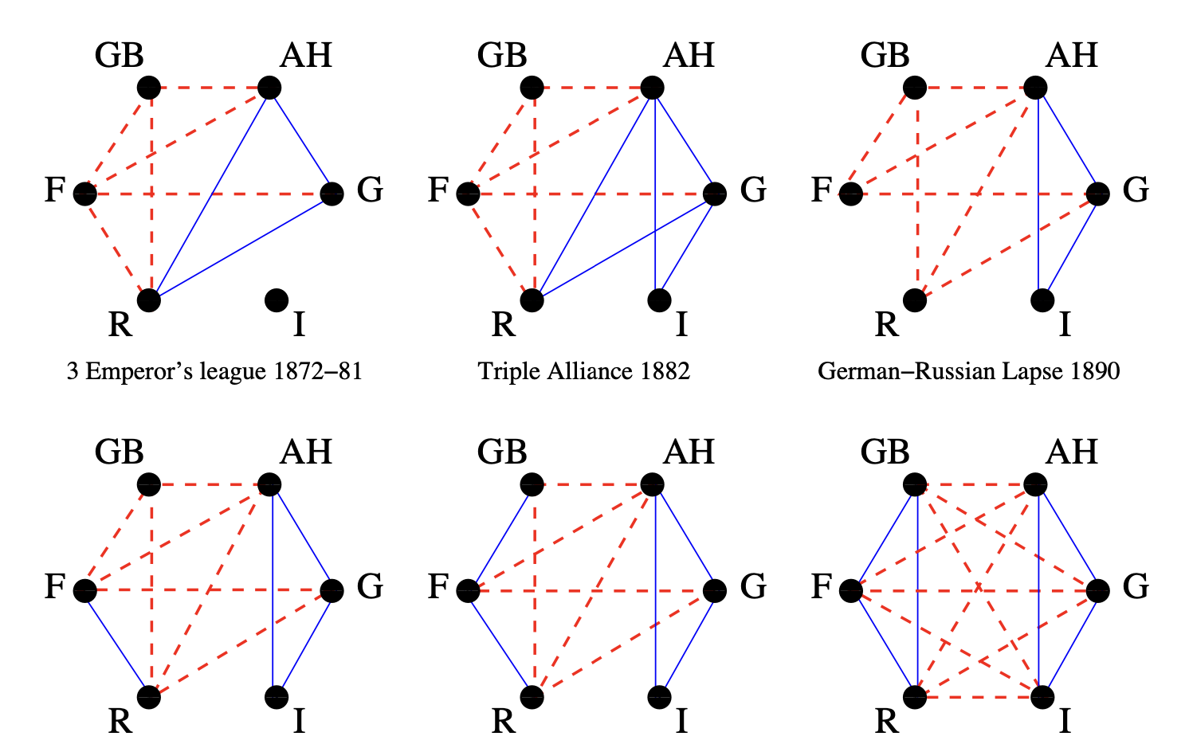
BACKGROUND
Fritz Heider (1946)
Proposed structural balance theory for signed social relations based on triads
Cartwright and Harary (1956)
Generalized Heider's theory to apply to other types of networks
Antal, Krapivsky and Redner (2006)
Used theory to study international relations from 1946 through 1999, found a pattern in network balance over time
From Doreian and Mrvar
Doreian and Mrvar (2019)
Applied balance theory to WW1 data

Slide 4
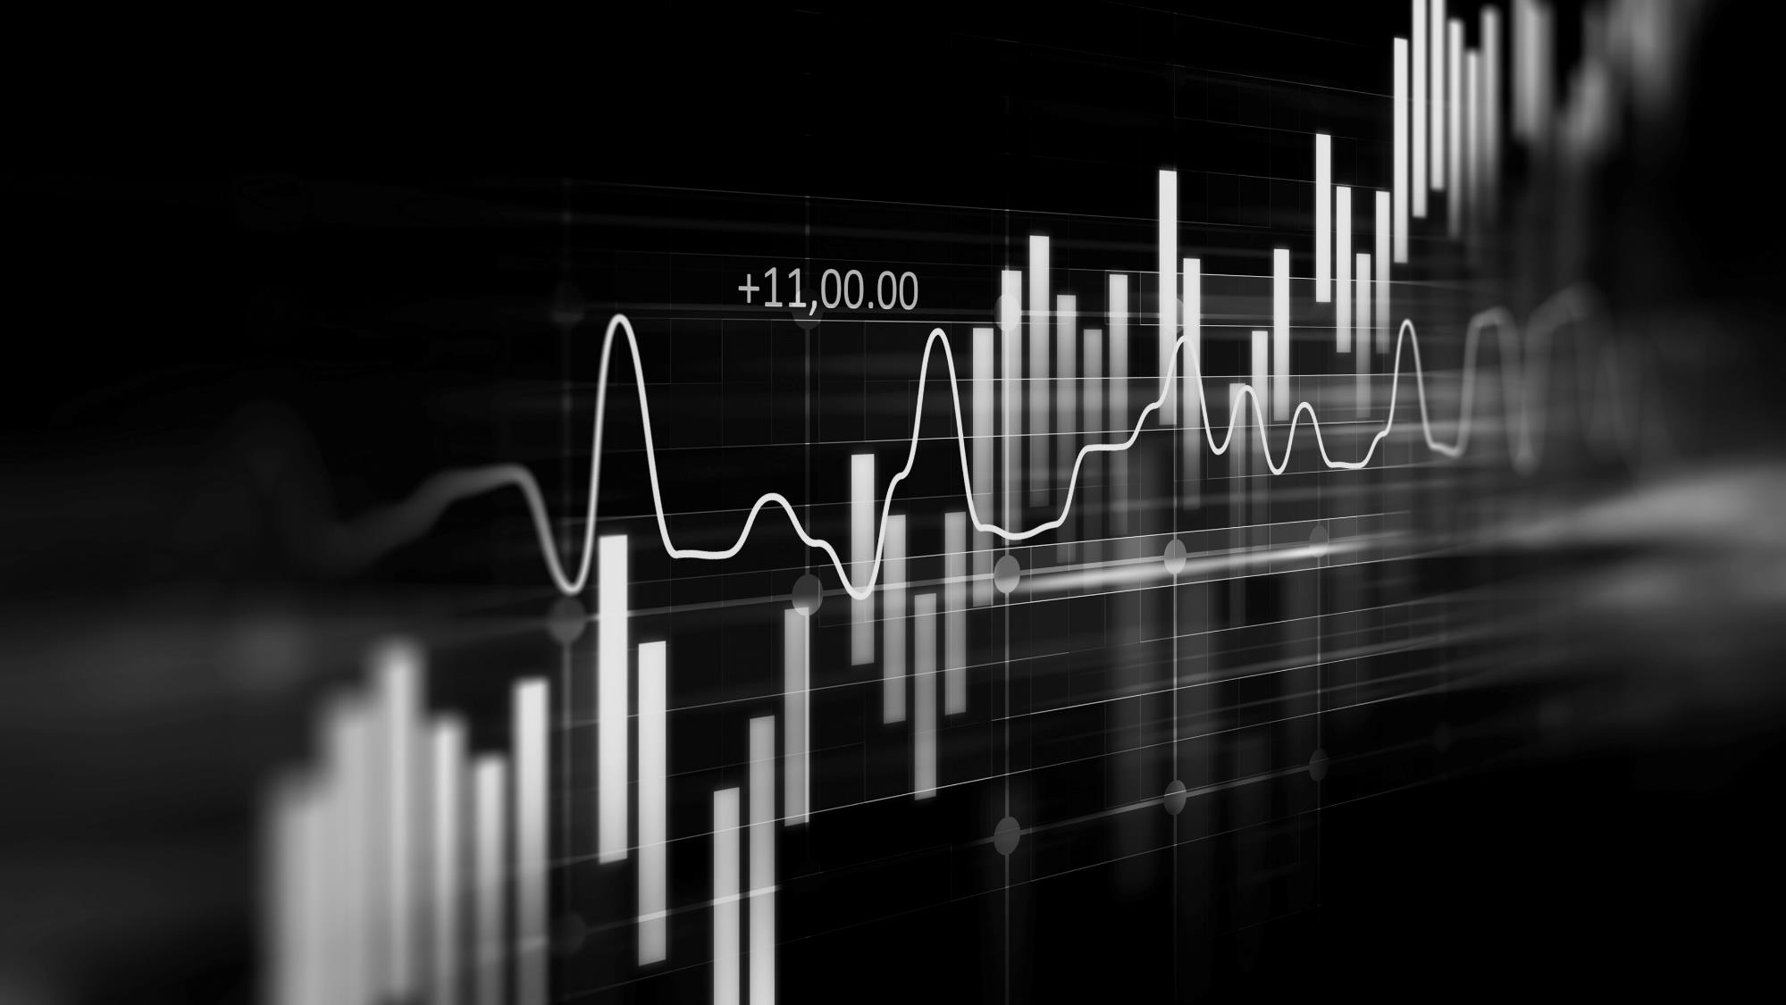
APPROACH
APPROACH
Visualize network as graph
10 Year timeline
Nodes = countries
Edges = alliances / conflicts
Used 10 years of structural balance data to create a line chart
Structural balance
Analyze line chart
Number of balanced triangles /
total number of possible triangles
Achieved similar sin wave trend to Antal
Divide & Conquer
Used the Louvain algorithm to detect clusters by positive edges, split clusters into 2 even sides

Slide 5
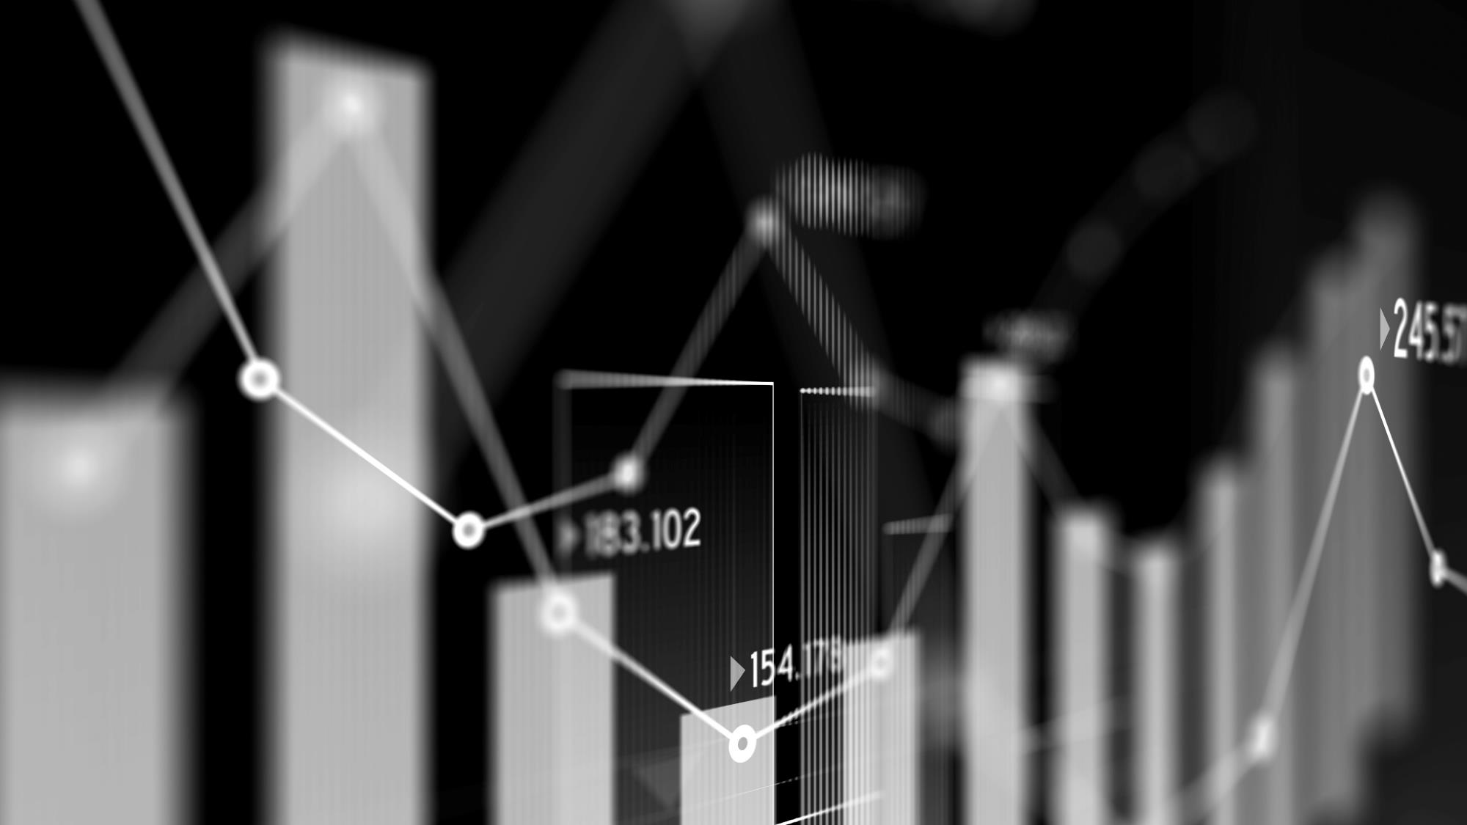
DATA
DATASETS
LIMITATIONS
WW1.CSV
WW2.CSV
2016-2025 timeline
Not enough time to implement blockmodeling, manually created instead
Subjective opinion on ally vs enemy vs neutral based on treaties and actions
Timeline only covers 10 years
Starting date dependent on trends

Slide 6
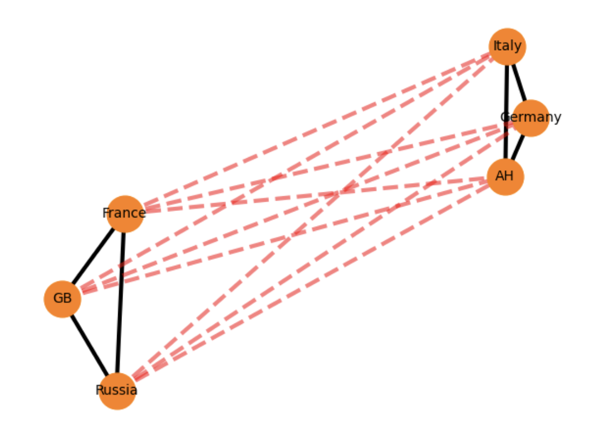
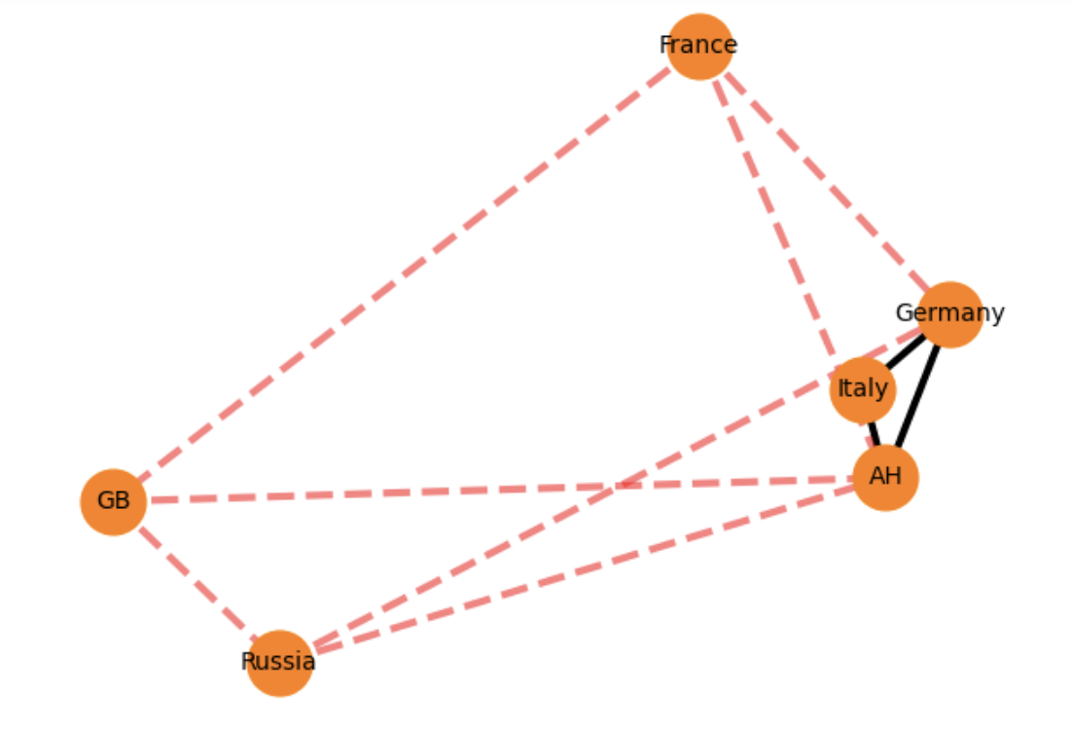
RESULTS (WW1)
1890
Prediction

Slide 7
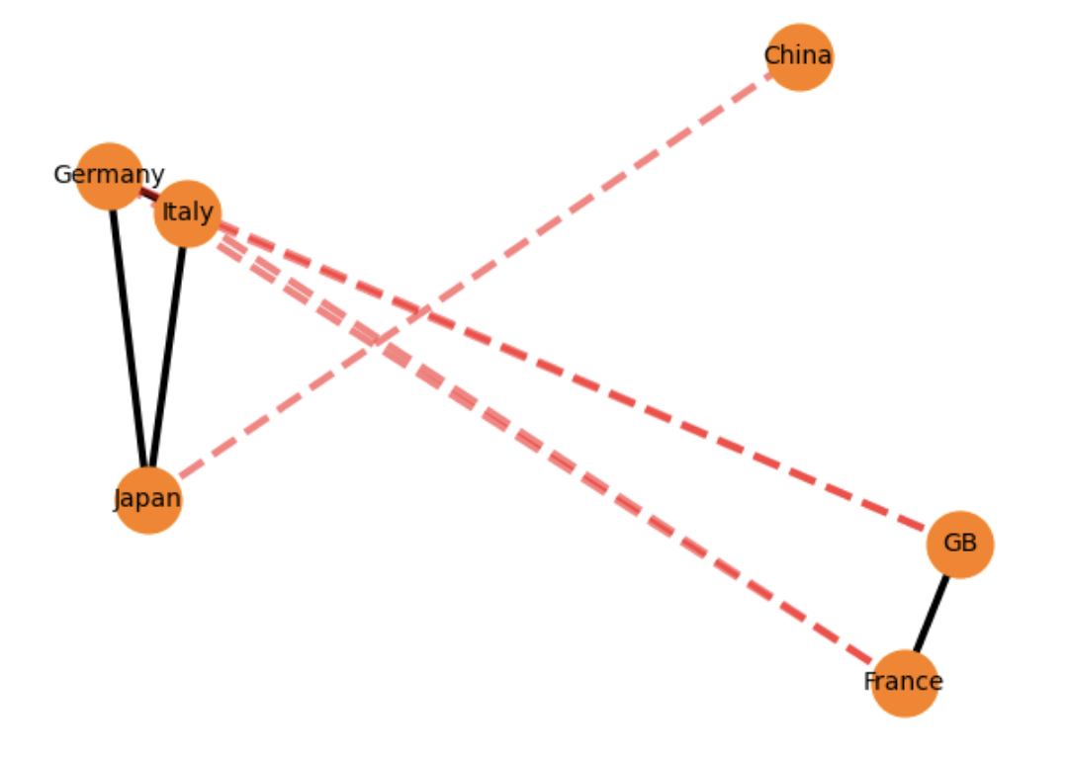
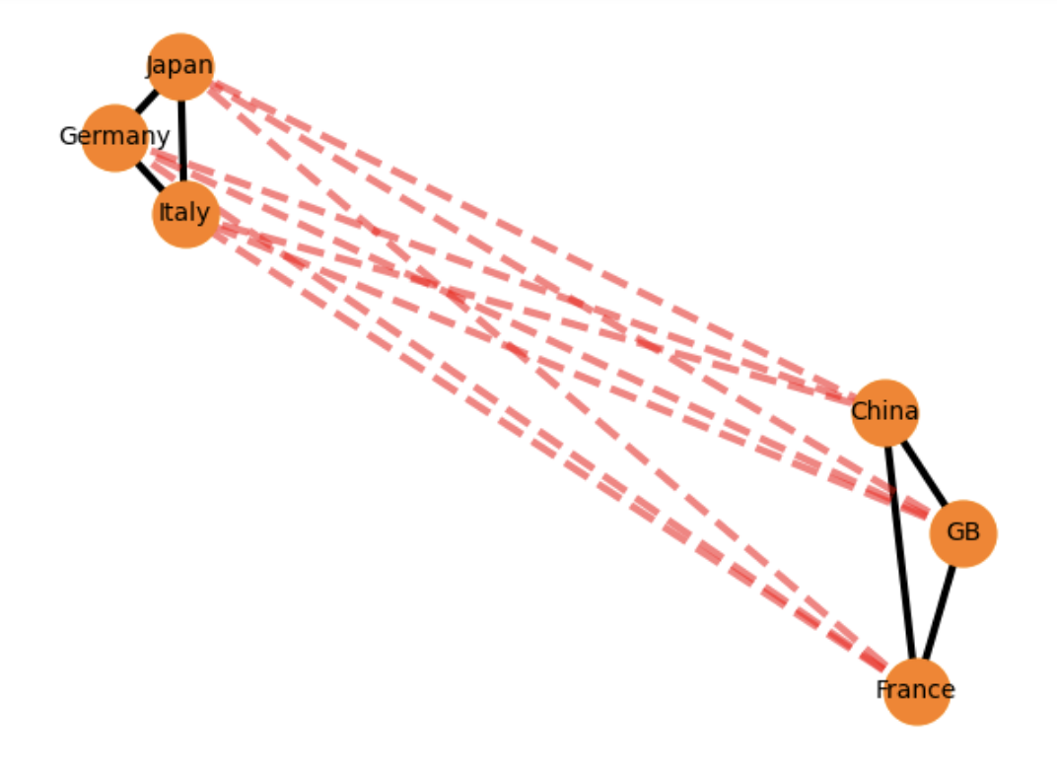
RESULTS (WW2)
1940
Prediction

Slide 8
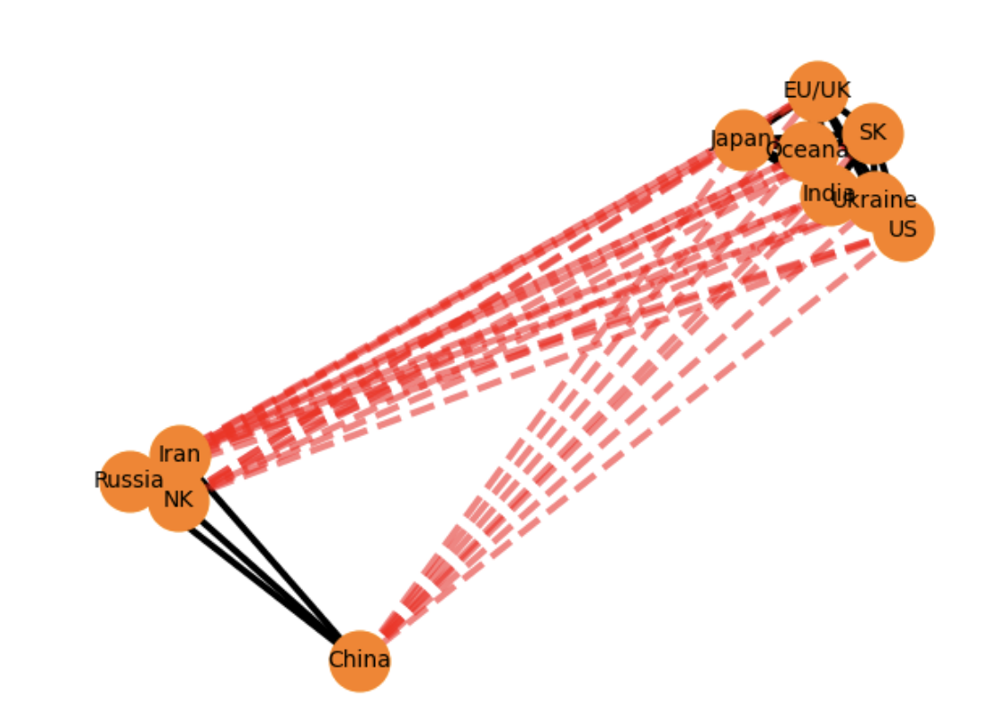
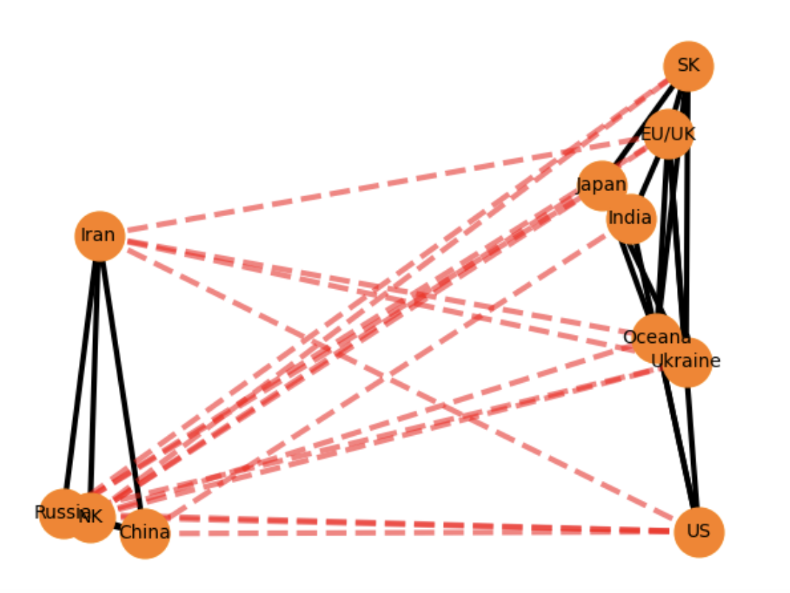
RESULTS (current)
?
2025

Slide 9
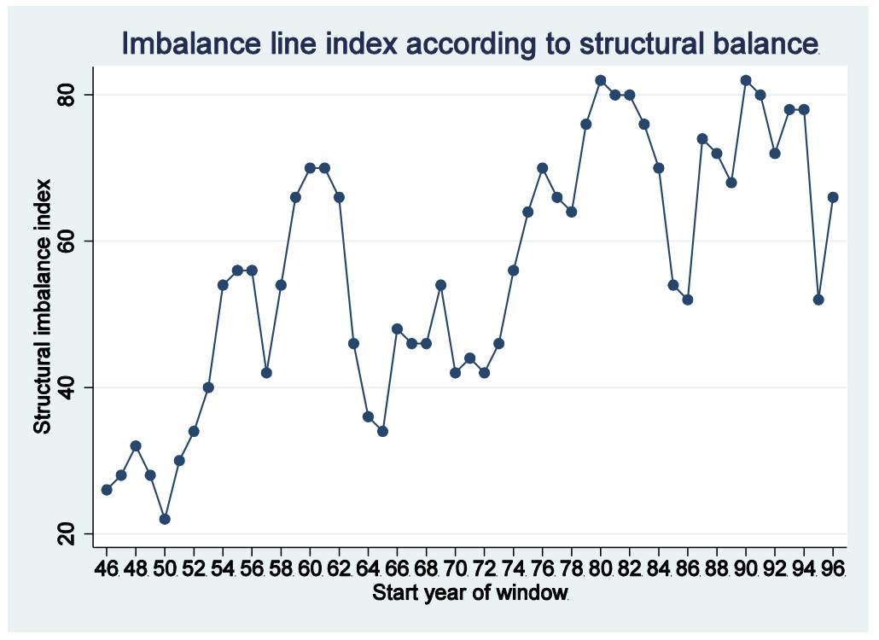
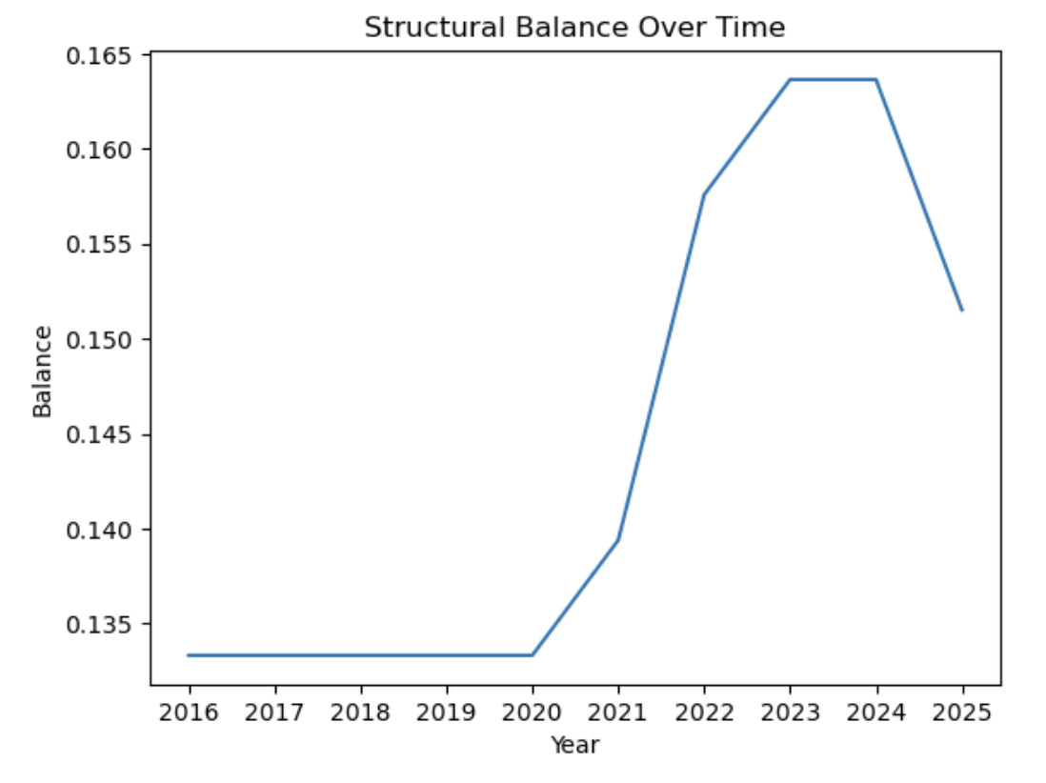
RESULTS (timeline)
Antal et al.

Slide 10
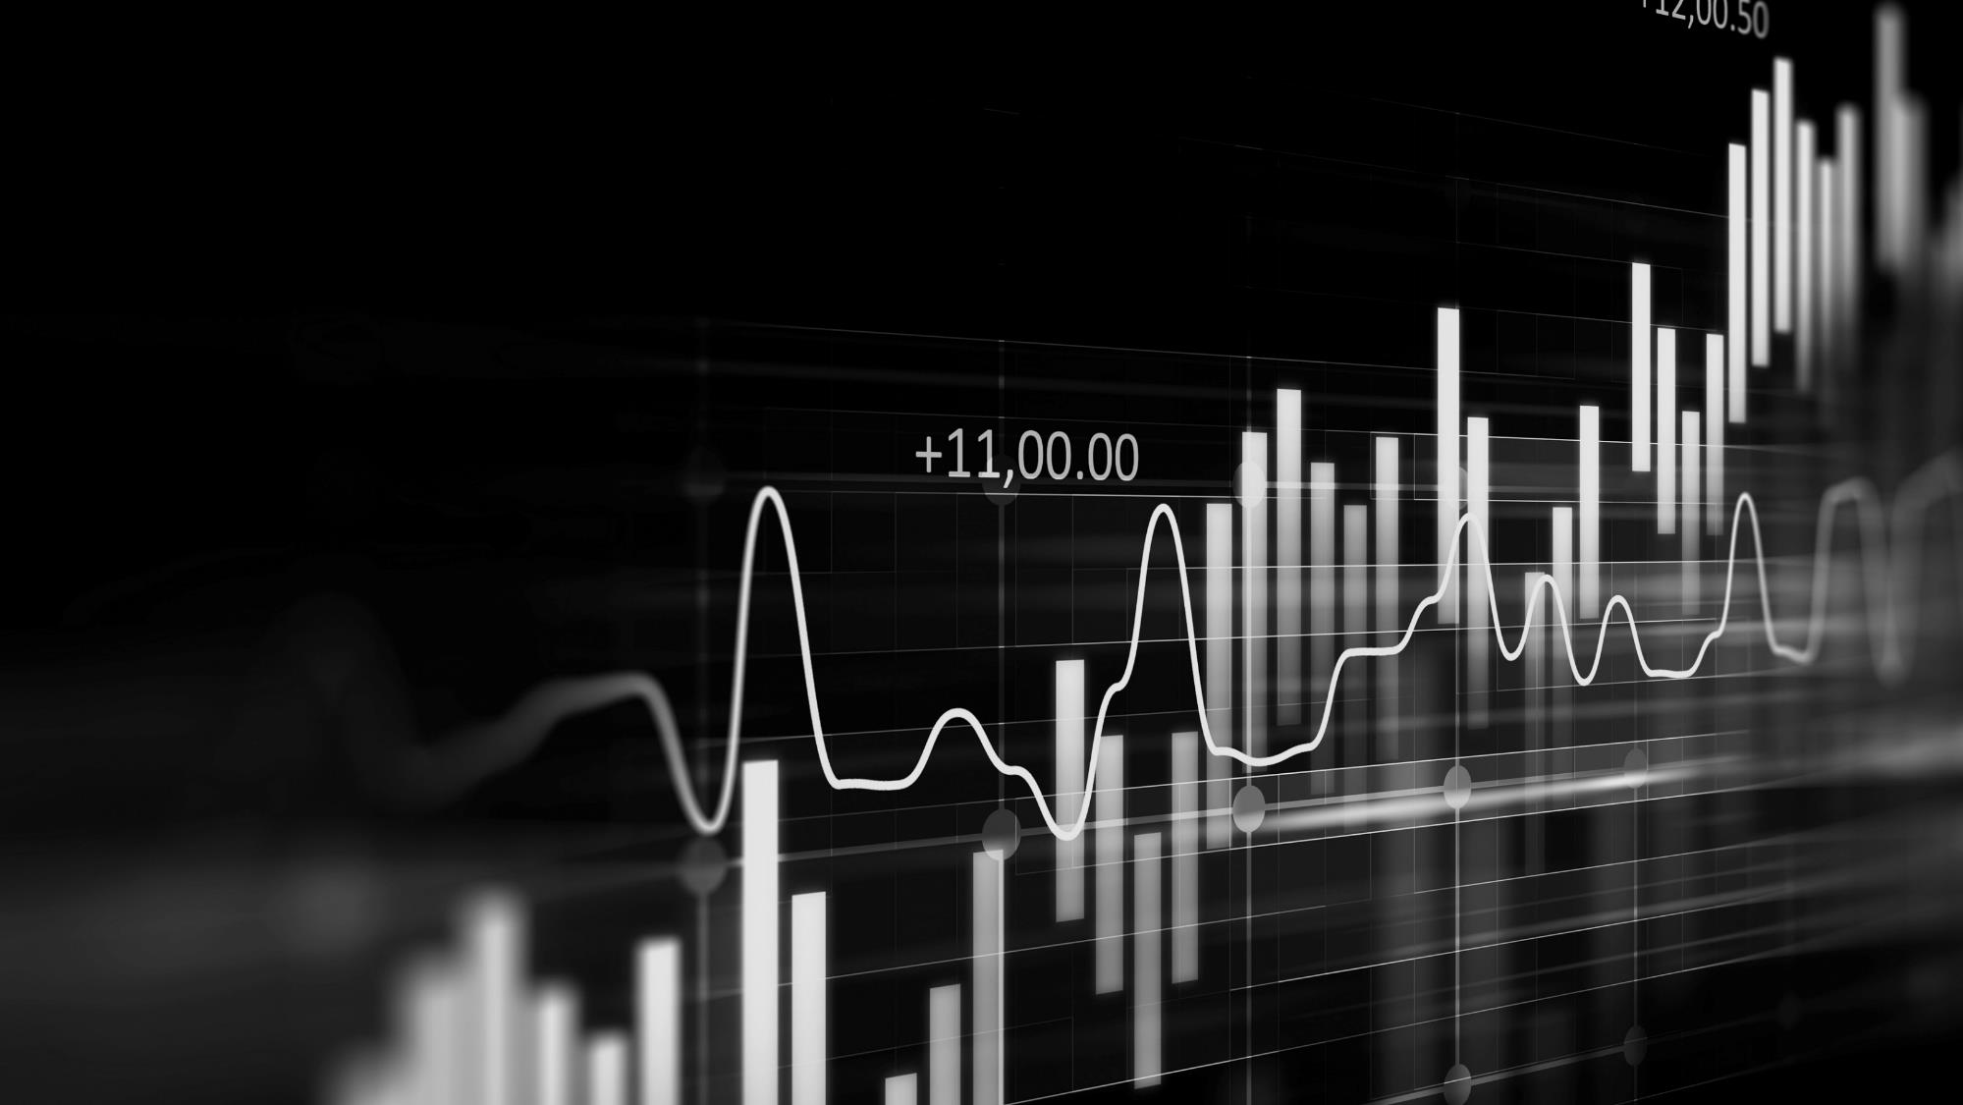
EVALUATION PLAN
Proposed Approaches
time series
Sin wave fitting
LSTM
Predict seasonality using model parameters
Home-grown algorithm using Fourier transform
Deep learning model to predict future points on the curve

Slide 11
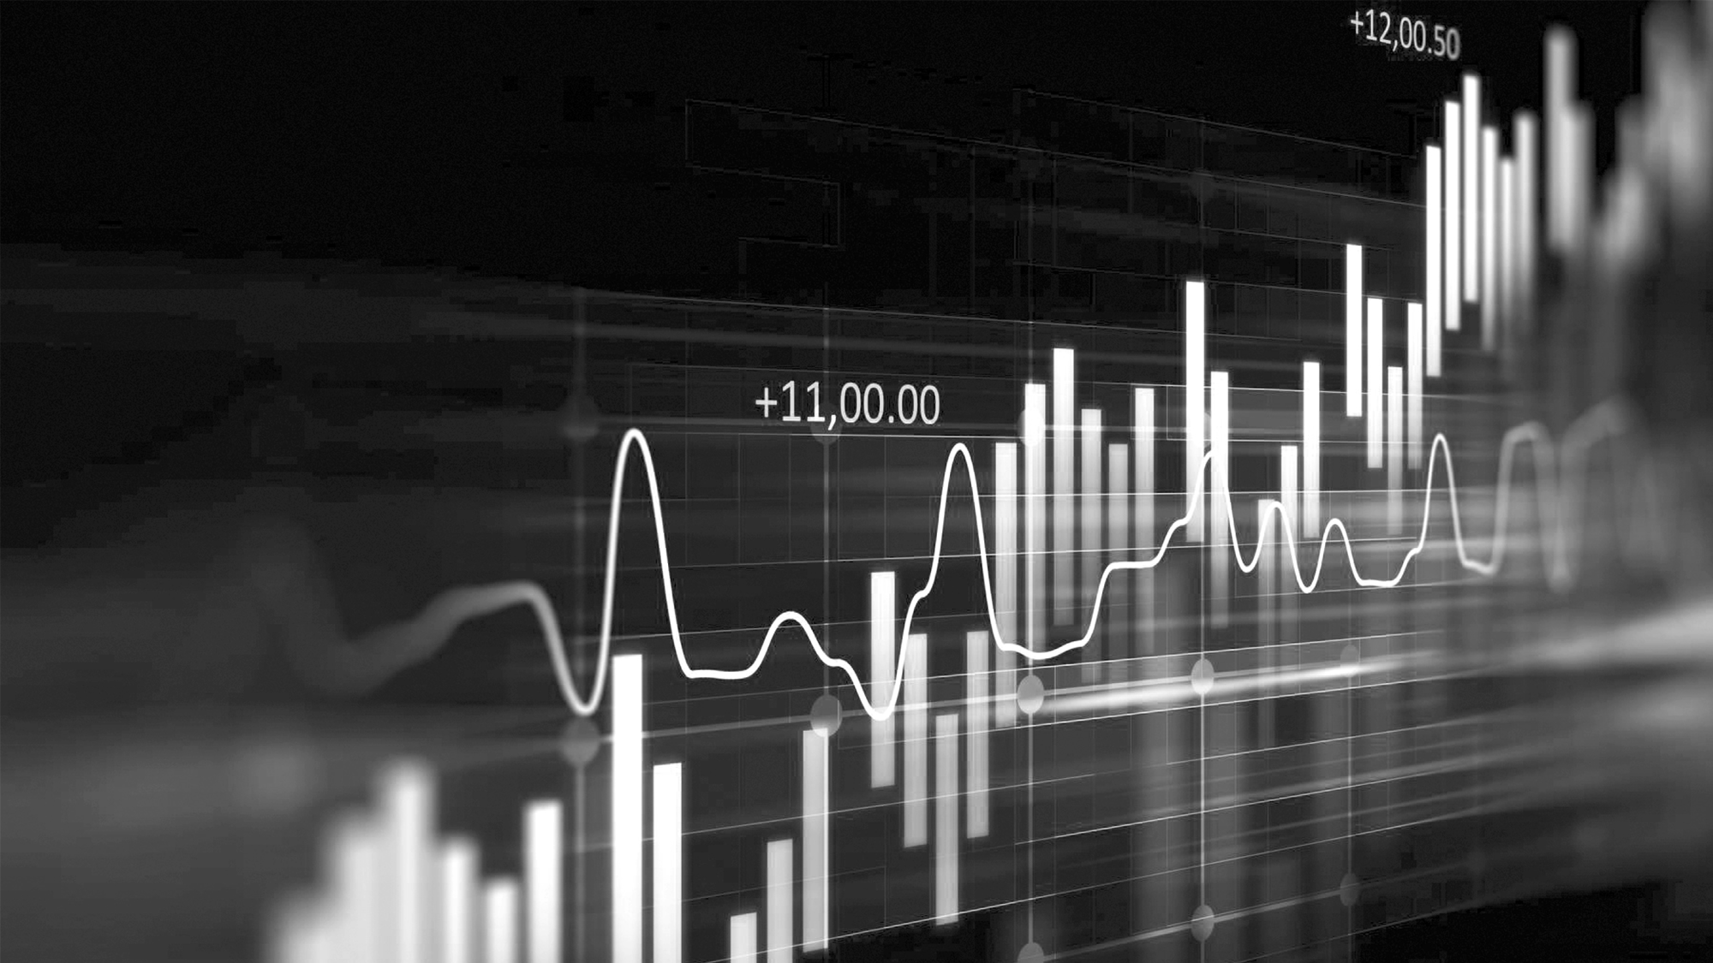
MOVING FORWARD
DATA
ANALYSIS
IMPROVE
Blockmodeling, CoW dataset
Try to predict the trend in balance
Add more details to the Louvain method

Slide 12
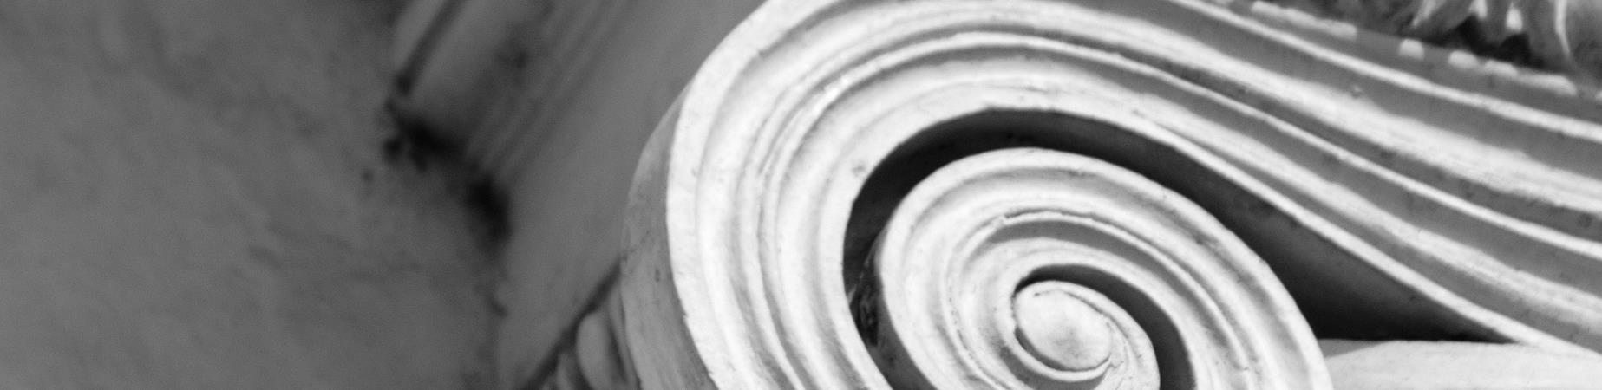
CONCLUSION
This is mostly an exploratory project. More detailed data processing and research is required to make a reliable prediction.
https://github.com/hziegel/Alliances

